Slide 1


Rental Property Management System
BY:
Aishwarya Balyaya
Divyesh Darji
Srushti Desai
Shrutika Salina

Slide 2
Objectives
To develop an efficient database system which eases the process of rental management
To track the profit margin using revenue generated
To find apartments based on budget preferences

Slide 3
Problem Statement
In this fast-paced world, there are so many ways to generate data, it has now become very essential that the data being generated is collected and managed in a structured manner so that it can be converted into useful information
It requires a robust database management system that facilitates connecting the customers with the appropriate property that suits their needs
Landlord finds the process of renting out their apartments very troublesome
The aim of our system is to design such a model that helps organization to manage all the customers along with keeping the track of organization’s profit and helping landlord to have a hassle-free experience for renting their apartments

Slide 4
Proposed Solution
Database has been created which stores data in normalized format by identifying dependencies and splitting the tables appropriately with proper Primary and Foreign key relationship
Landlord has a view where he can check all the tenants who are currently living or who used to live in his apartment
Customers can find apartments based on their preferences for locality, budget
Maintenance requests can be tracked for the apartments to find out which apartment required more maintenance
Revenues generated can be identified using the rent paid by the tenants each month

Slide 5
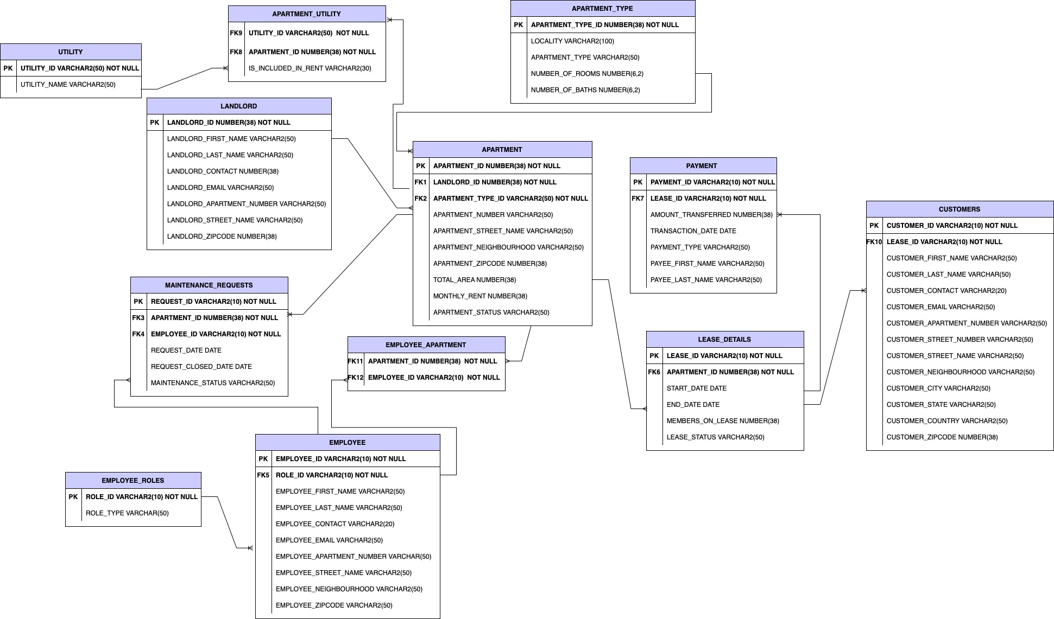
Entity Relationship Diagram

Slide 6
CONTRIBUTION
Aishwarya Balyaya
Created entire datasets manually
Created 3 tables, 3 procedures and respective table insertion scripts
Created Views, Sequence, Grant Access, Index, Triggers and Reports
Divyesh Darji
Created entire datasets manually
Created 3 tables, 3 procedures and respective table insertion scripts
Created Views, Sequence, Grant Access, Index, Triggers and Reports
Shrutika Salian
Created entire datasets manually
Created 3 tables, 3 procedures and respective table insertion scripts
Created Views, Sequence, Grant Access, Index, Triggers and Reports
Srushti Desai
Created entire datasets manually
Created 3 tables, 3 procedures and respective table insertion scripts
Created Views, Sequence, Grant Access, Index, Triggers and Reports

Slide 7
Execution flow
TABLE-CREATIONS
SEQUENCE
PACKAGE_DEFINITION
PACKAGE_BODY
TRIGGERS
INSERTIONS
INDEX
USER GRANT ACCESS
VIEWS
REPORTS

Slide 8

Demo

Slide 9
Thank you

